Slide 1
Browser and
E-mail Basics

Slide 2
Objectives
Learn about the Internet and the World Wide Web
Learn about Web sites, Web pages, and Web browsers
Learn about Web addresses
Learn about search engines and Uniform Resource Locators
Use tabbed browsing to navigate Web pages
Use the Favorites Center
Save and print a Web page
Save a graphic from a Web page
New Perspectives on Microsoft Office 2007: Windows XP Edition

Slide 3
Objectives
Learn about e-mail and e-mail software
Send, receive, reply to, and print an e-mail message
Add and delete contacts in the Address Book
Add an attachment to a message
New Perspectives on Microsoft Office 2007: Windows XP Edition

Slide 4
The Internet and the World Wide Web
The Internet is a worldwide collection of networks that allows people to communicate and share information easily
The Web is a collection of files that reside on computers, called Web servers
  Web servers are connected to each other through the Internet
The software you use to connect your computer to the Web server is your Web browser.
  Common Web browsers are Microsoft Internet Explorer, Mozilla Firefox, and Apple Safari
    Home page
  These browsers use a standard Graphical User Interface design
New Perspectives on Microsoft Office 2007: Windows XP Edition

Slide 5
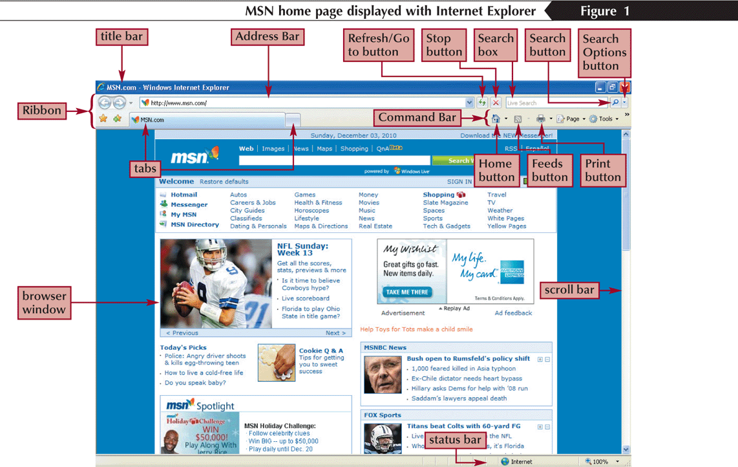
Starting Microsoft Internet Explorer
New Perspectives on Microsoft Office 2007: Windows XP Edition

Slide 6
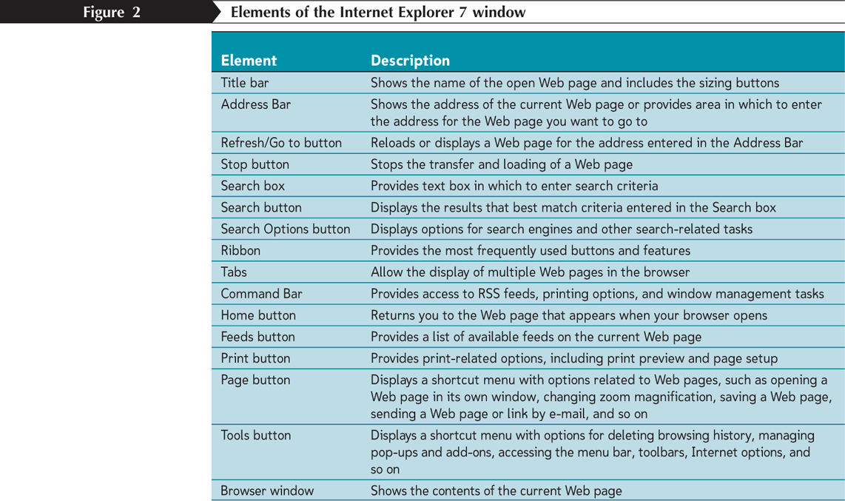
Elements of the Internet Explorer 7 Window
New Perspectives on Microsoft Office 2007: Windows XP Edition

Slide 7
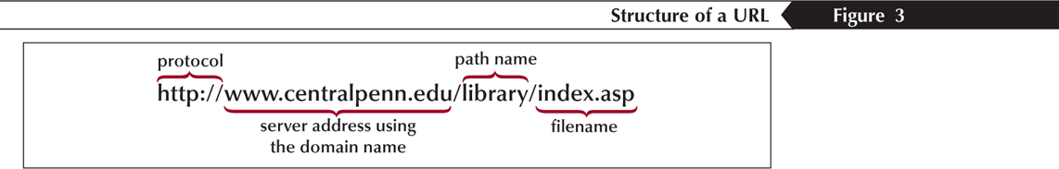
Search Engines and
Uniform Resource Locators
Search engines are Web pages that browsers use to conduct searches of the Web for words or expressions
  Search criteria
You can use your Web browser to access a Web page using a Uniform Resource Locator (URL)
New Perspectives on Microsoft Office 2007: Windows XP Edition

Slide 8
Entering a URL in the Address Bar
Select the current URL in the Address Bar
Type the URL of the Web page you want to retrieve
Press the Enter key (or click the Go to button) to display the Web page in the browser window
New Perspectives on Microsoft Office 2007: Windows XP Edition

Slide 9
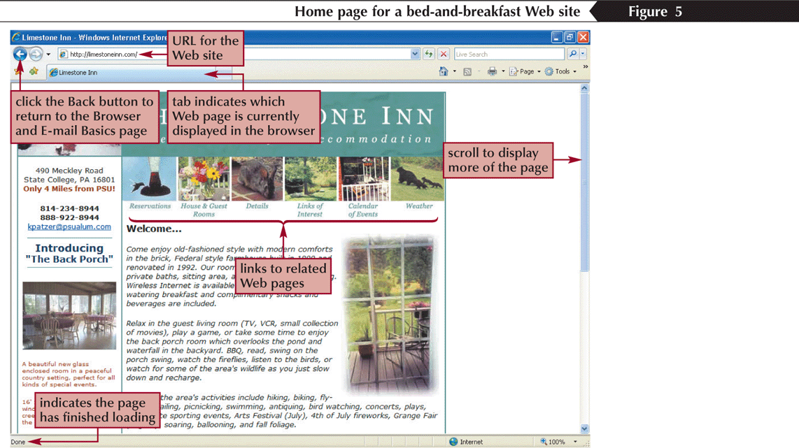
Entering a URL in the Address Bar
New Perspectives on Microsoft Office 2007: Windows XP Edition

Slide 10
Tabbed Browsing
Tabbed browsing lets you display multiple Web pages in the same browser window
On the Ribbon, click the New Tab button
Begin typing the Web address for the site you want to visit
Press the Enter key
or
Right-click an existing tab, and then click New Tab on the shortcut menu
Begin typing the Web address for the site you want to visit
Press the Enter key
or
Press and hold the Ctrl key
Click a link in the open Web page
New Perspectives on Microsoft Office 2007: Windows XP Edition

Slide 11
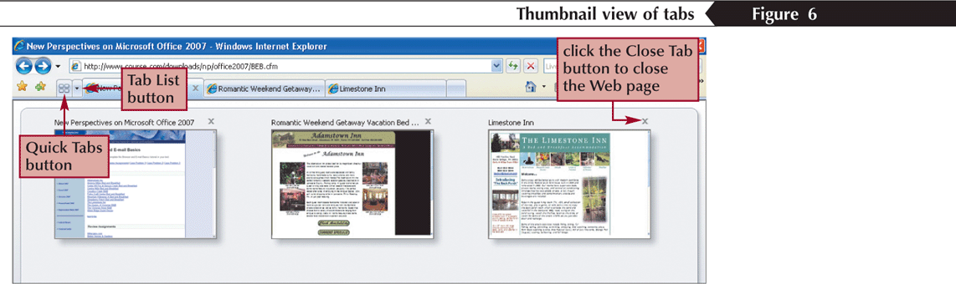
Tabbed Browsing
New Perspectives on Microsoft Office 2007: Windows XP Edition

Slide 12
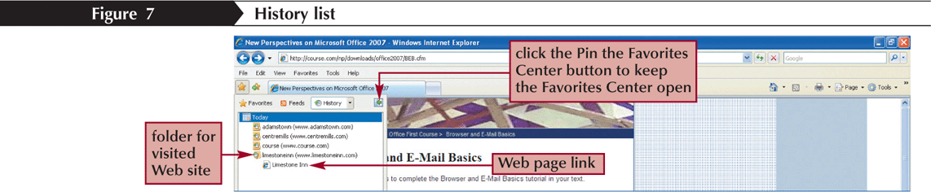
Using the Favorites Center
Internet Explorer 7 brings together the Web sites you have visited and the sites you go to on a regular basis in one central location—the Favorites Center
The History list tracks the Web sites you visit over a time period
New Perspectives on Microsoft Office 2007: Windows XP Edition

Slide 13
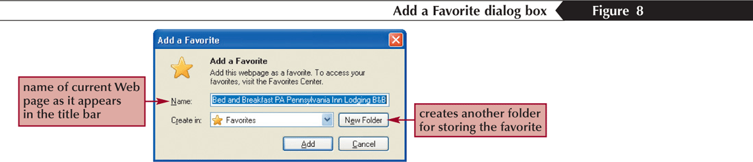
Using the Favorites List
You can save the URL of a Web site as a favorite in the Favorites list
New Perspectives on Microsoft Office 2007: Windows XP Edition

Slide 14
Organizing the Favorites List
On the Ribbon, click the Add to Favorites button
Click Organize Favorites on the menu to open the Organize Favorites dialog box
To create a new folder, click the New Folder button, type the name for the new folder, and then press the Enter key
To move a favorite into a folder, select the item, click the Move button, select the folder for the item in the Browse For Folder dialog box, and then click the OK button
To remove a favorite, select the item, click the Delete button, and then click the Yes button to confirm the removal of the item from the Favorites list
New Perspectives on Microsoft Office 2007: Windows XP Edition

Slide 15
Subscribing to an RSS Feed
A feed, also known as an RSS feed, is a program that allows the downloading, storing, and accessing of information from a Web site directly to your computer
Go to the Web page that has the feed you want to subscribe to
Click the View Feeds button arrow on the Command Bar to view the list of available feeds on the Web page
Click a feed to go directly to the page with the feed
Click the Add to Favorites button, and then click Subscribe to the Feed
Enter a name for the feed (or leave the one automatically displayed), select or create a folder in which to store the feed, and then click the Subscribe button
New Perspectives on Microsoft Office 2007: Windows XP Edition

Slide 16
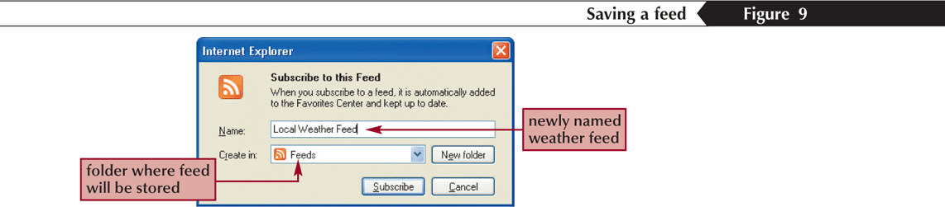
Subscribing to an RSS Feed
New Perspectives on Microsoft Office 2007: Windows XP Edition

Slide 17
Printing a Web Page
Display the Web page you wish to print
Click the Print button arrow on the Command Bar, and then click Print
Click the Print button
New Perspectives on Microsoft Office 2007: Windows XP Edition

Slide 18
Saving a Web Page
Click the Page button on the Command Bar to open the menu, and then click Save As
Type the file name and choose the location
Click the Save button
New Perspectives on Microsoft Office 2007: Windows XP Edition

Slide 19
Exploring E-mail
E-mail, or electronic mail, is an efficient way to exchange messages with others on a network
This network may be small and self-contained, such as within an office, or as large as the Internet
E-mail messages can go to only one recipient or to dozens of recipients at once
When you send a message, it travels through the network to an e-mail server
The e-mail server stores messages until the recipient(s) request them
New Perspectives on Microsoft Office 2007: Windows XP Edition

Slide 20
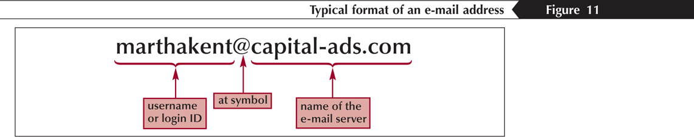
Addressing E-mail
New Perspectives on Microsoft Office 2007: Windows XP Edition

Slide 21
Send and Receive E-mail Using Microsoft Outlook Express
To access your e-mail account you also need an e-mail program, which is also called e-mail client software
You use the e-mail program to open, print, delete, reply to, forward, and save mail from your e-mail server
One such program is Microsoft's Outlook Express, which installs as part of Internet Explorer
Outlook Express can be accessed through the Start menu on the All Programs submenu
New Perspectives on Microsoft Office 2007: Windows XP Edition

Slide 22
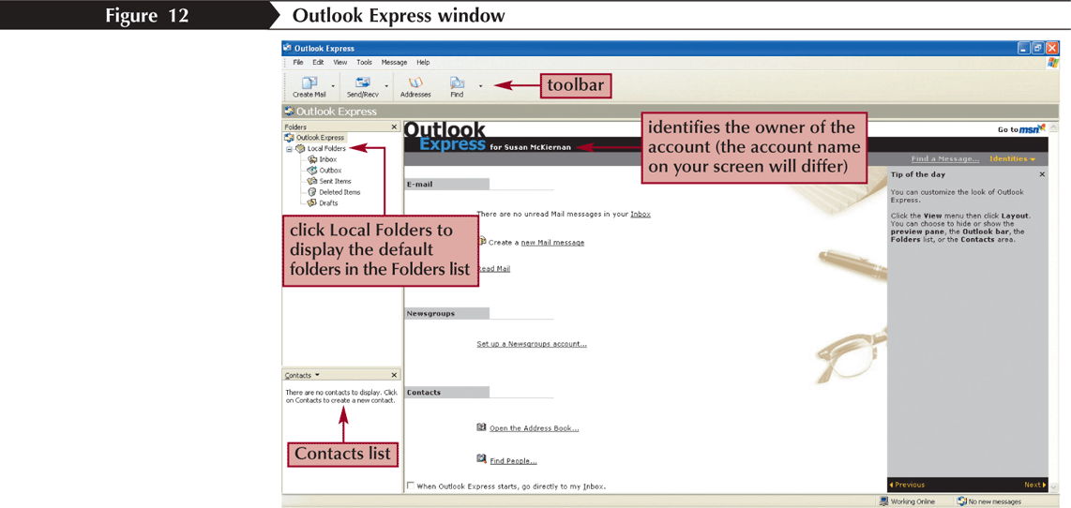
Microsoft Outlook Express
New Perspectives on Microsoft Office 2007: Windows XP Edition

Slide 23
Send and Receive E-mail
To send an e-mail message:
  Press the Create Mail button on the Outlook Express toolbar
  Type in the e-mail addresses of the recipient
  Type your subject matter
  Type your message and then click the Send button
To retrieve mail that has been sent to you:
  Click the Send/Recv button on the toolbar
  Outlook Express will contact your e-mail server and download your e-mail messages
To reply to a message:
  Click the Reply button
  The recipient address and the subject matter are automatically filled in
  When you have completed typing your reply, click the Send button
New Perspectives on Microsoft Office 2007: Windows XP Edition

Slide 24
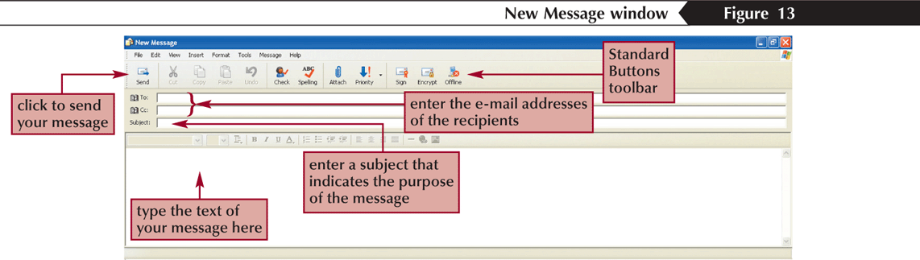
The Outlook Express
New Message dialog box
New Perspectives on Microsoft Office 2007: Windows XP Edition

Slide 25
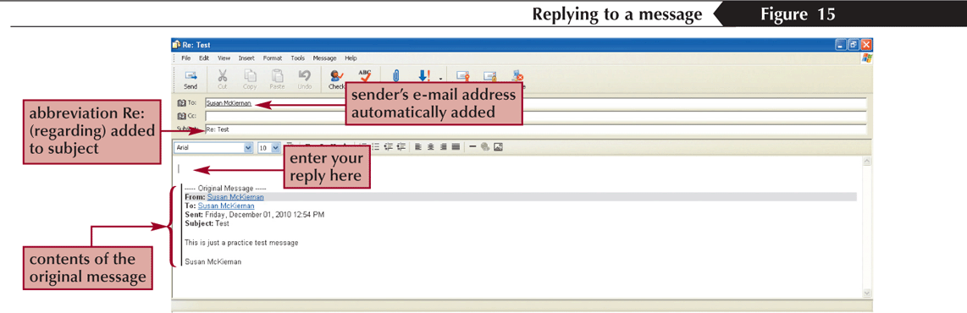
Reply to an E-mail Message
New Perspectives on Microsoft Office 2007: Windows XP Edition

Slide 26
Adding Contacts to the Address Book
Click the Addresses button on the toolbar (or click Tools on the menu bar, and then click Address Book) to open the Address Book window, click the New button, and then click New Contact
In the Properties dialog box, enter the first and last names (the middle name, title, and nickname are optional). Modify the display name if necessary
Enter the e-mail address and then click the Add button
Enter additional information on the remaining tabs (optional)
Click the OK button, and then close the Address Book
or
Display a message from the sender you want to add as a contact
Right-click the sender’s name in the From text box, and then click Add Sender to Address Book on the shortcut menu
New Perspectives on Microsoft Office 2007: Windows XP Edition

Slide 27
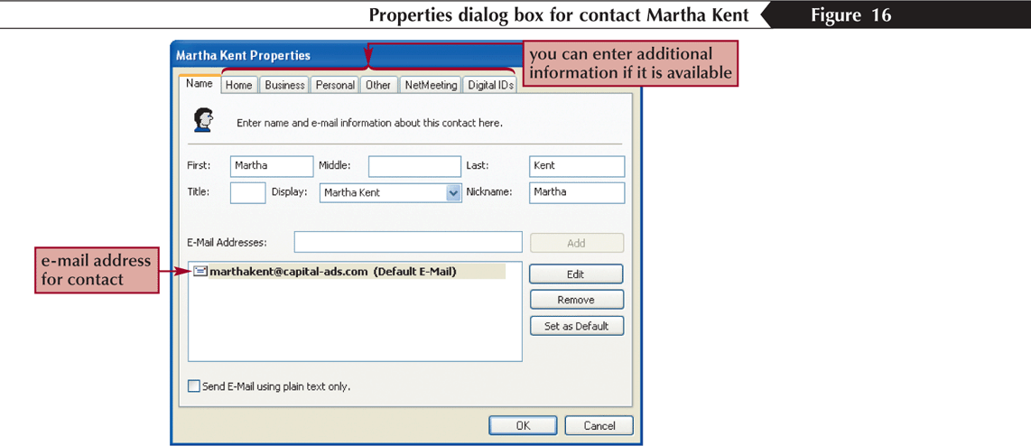
Adding Contacts to the Address Book
New Perspectives on Microsoft Office 2007: Windows XP Edition

Slide 28
Attaching a File to a Message
To attach a file to a message, first create a new message and click the Attach button on the toolbar
Browse for and select the file you wish to attach to the message
After selecting the file, complete your message and click the Send button
New Perspectives on Microsoft Office 2007: Windows XP Edition

Slide 29
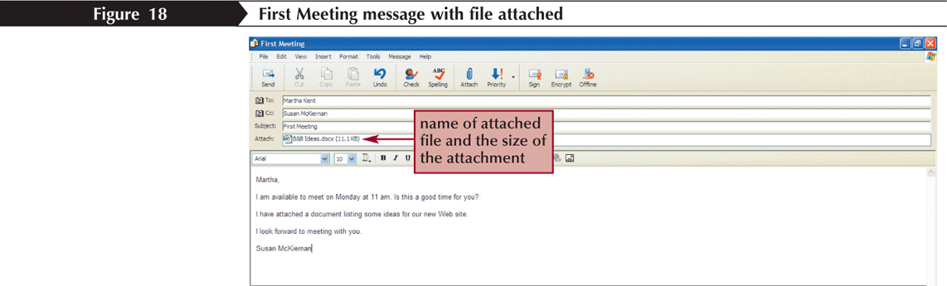
Message with File Attached
New Perspectives on Microsoft Office 2007: Windows XP Edition

Slide 30
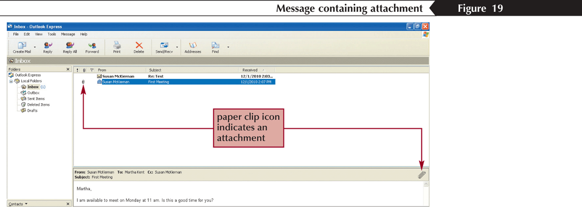
Receiving a Message with an Attachment
New Perspectives on Microsoft Office 2007: Windows XP Edition

